Slide 1
The Color Glove
TEAM MEMBERS & ROLES
DOMINIC POLCYN: PROGRAMMING, TESTER
KAITLYN YOUNGER: DESIGN ASPECTS, COLLECTING MATERIALS, PROGRAMMING HELP
AYUSH PANT: PROJECT DOCUMENTATION, TIMELINE MANAGER
THIEN TRAN: PROGRAMMING, COLLECTING DATA

Slide 2

1
Target Audience
2
Pain Point
Table of Contents
3
Product Introduction
4
Functionality
5
In Depth Design
6
User Feedbacks
7
Challenges & Limitations

Slide 3
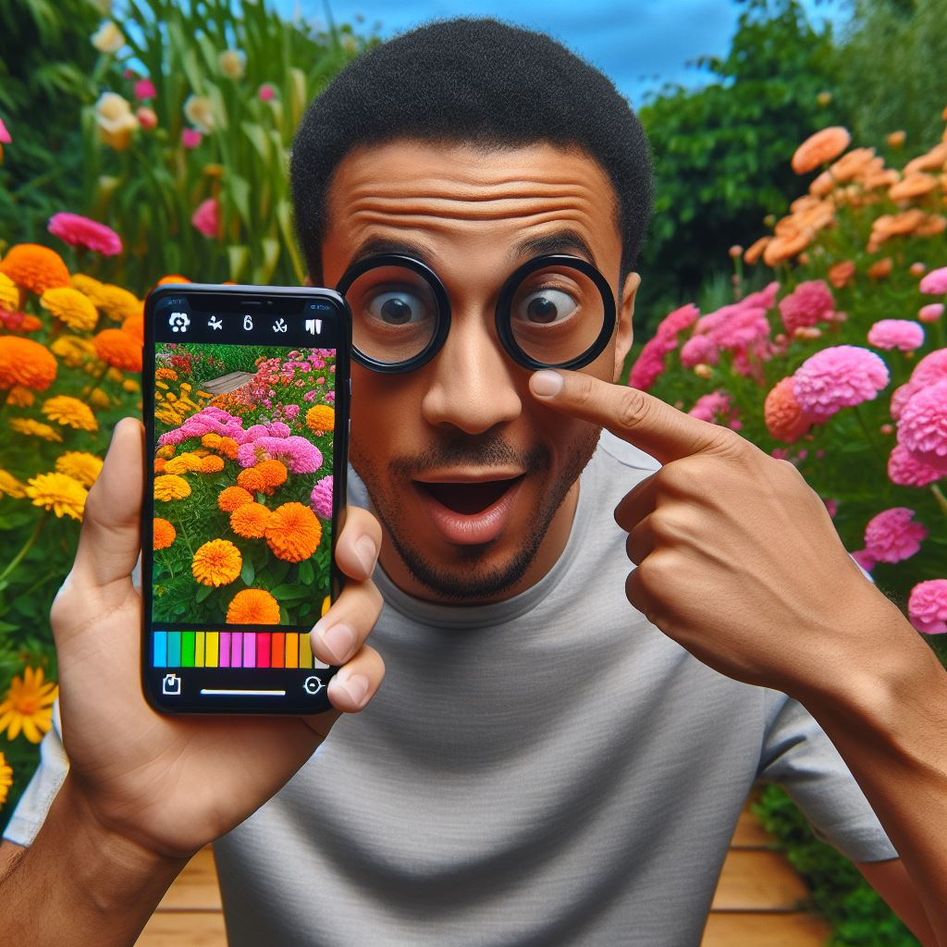
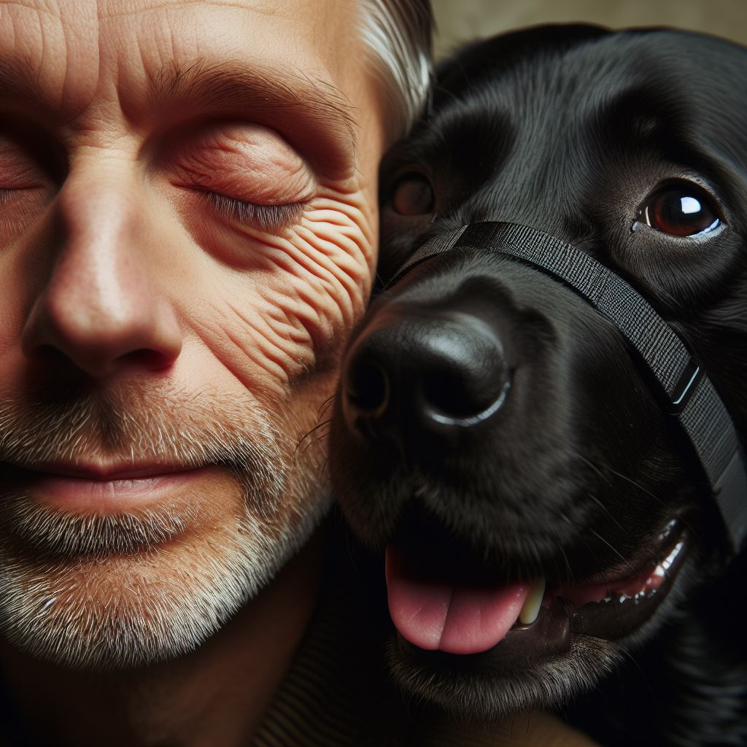
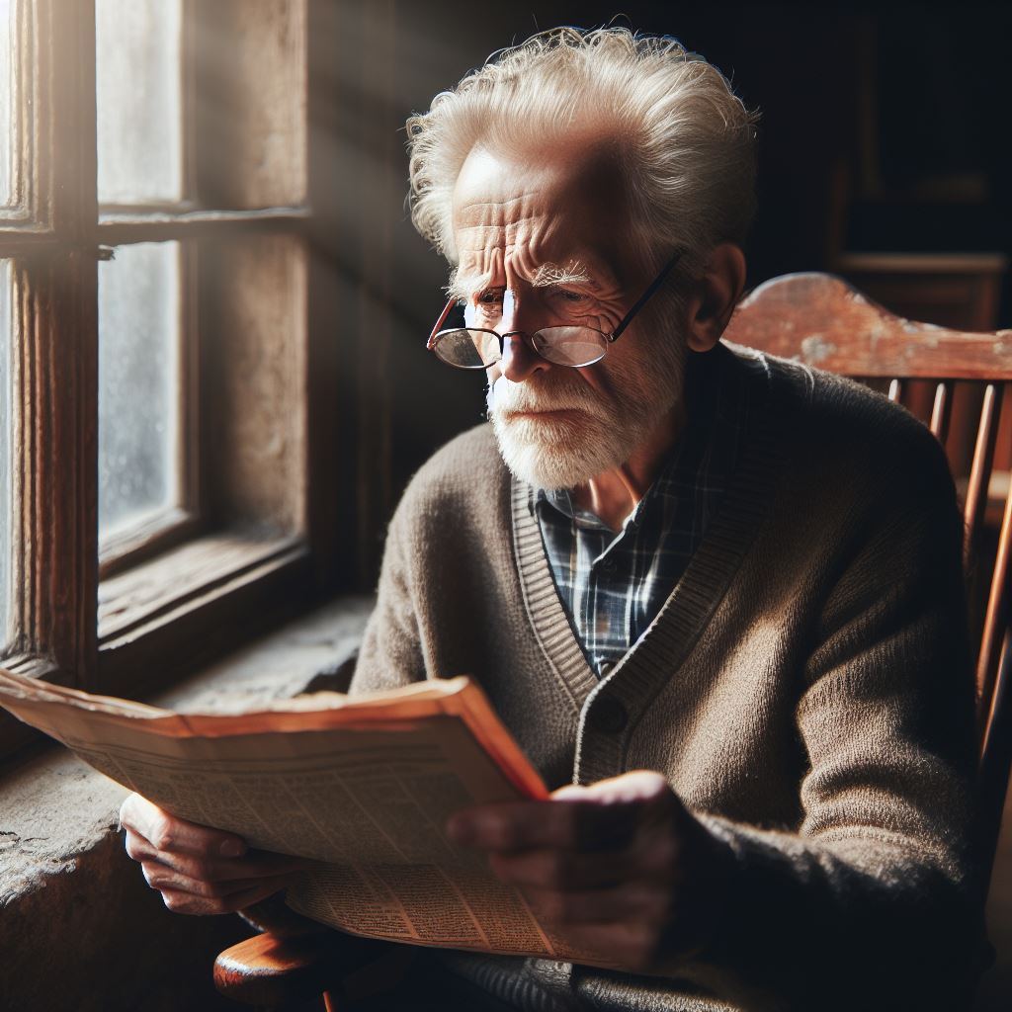
TARGET AUDIENCE
COLOR BLINDNESS
BLIND INDIVIDUALS
ELDERLY INDIVIDUALS
Individuals struggle to distinguish between certain colors.
People who are completely blind may not be able to perceive color at all.
Older adults who experience age-related vision changes.

Slide 4
PAIN POINTS
Trouble detecting color of fabrics
Can’t always just wear a t-shirt and jeans
Special events require matching colors
Examples:
Black denim or blue denim
Black blazer & pants for suit
Green for St Patrick's Day
Maroon & gold for an ASU game

Slide 5
PRODUCT INTRODUCTION
Description
- A glove with electronic components
Features
- Detect the distance
- Detect the color
- Speak the color
Objective
- Match clothing
- Enhance independence
- Promote social inclusion

Slide 6
FUNCTIONALITY
Power button
Vibrates when not close enough
When close, begins to detect color
Speaks detected color into headphones
Resets
Kaitlyn

Slide 7
IN DEPTH DESIGN
Adjustment Strap
Ultrasonic on thumb
RGB on index
Other finger holes cut
Vibrator on palm
Button on side
Raspberry Pi and GPIO board on glove
Headphones for output
Kaitlyn

Slide 8
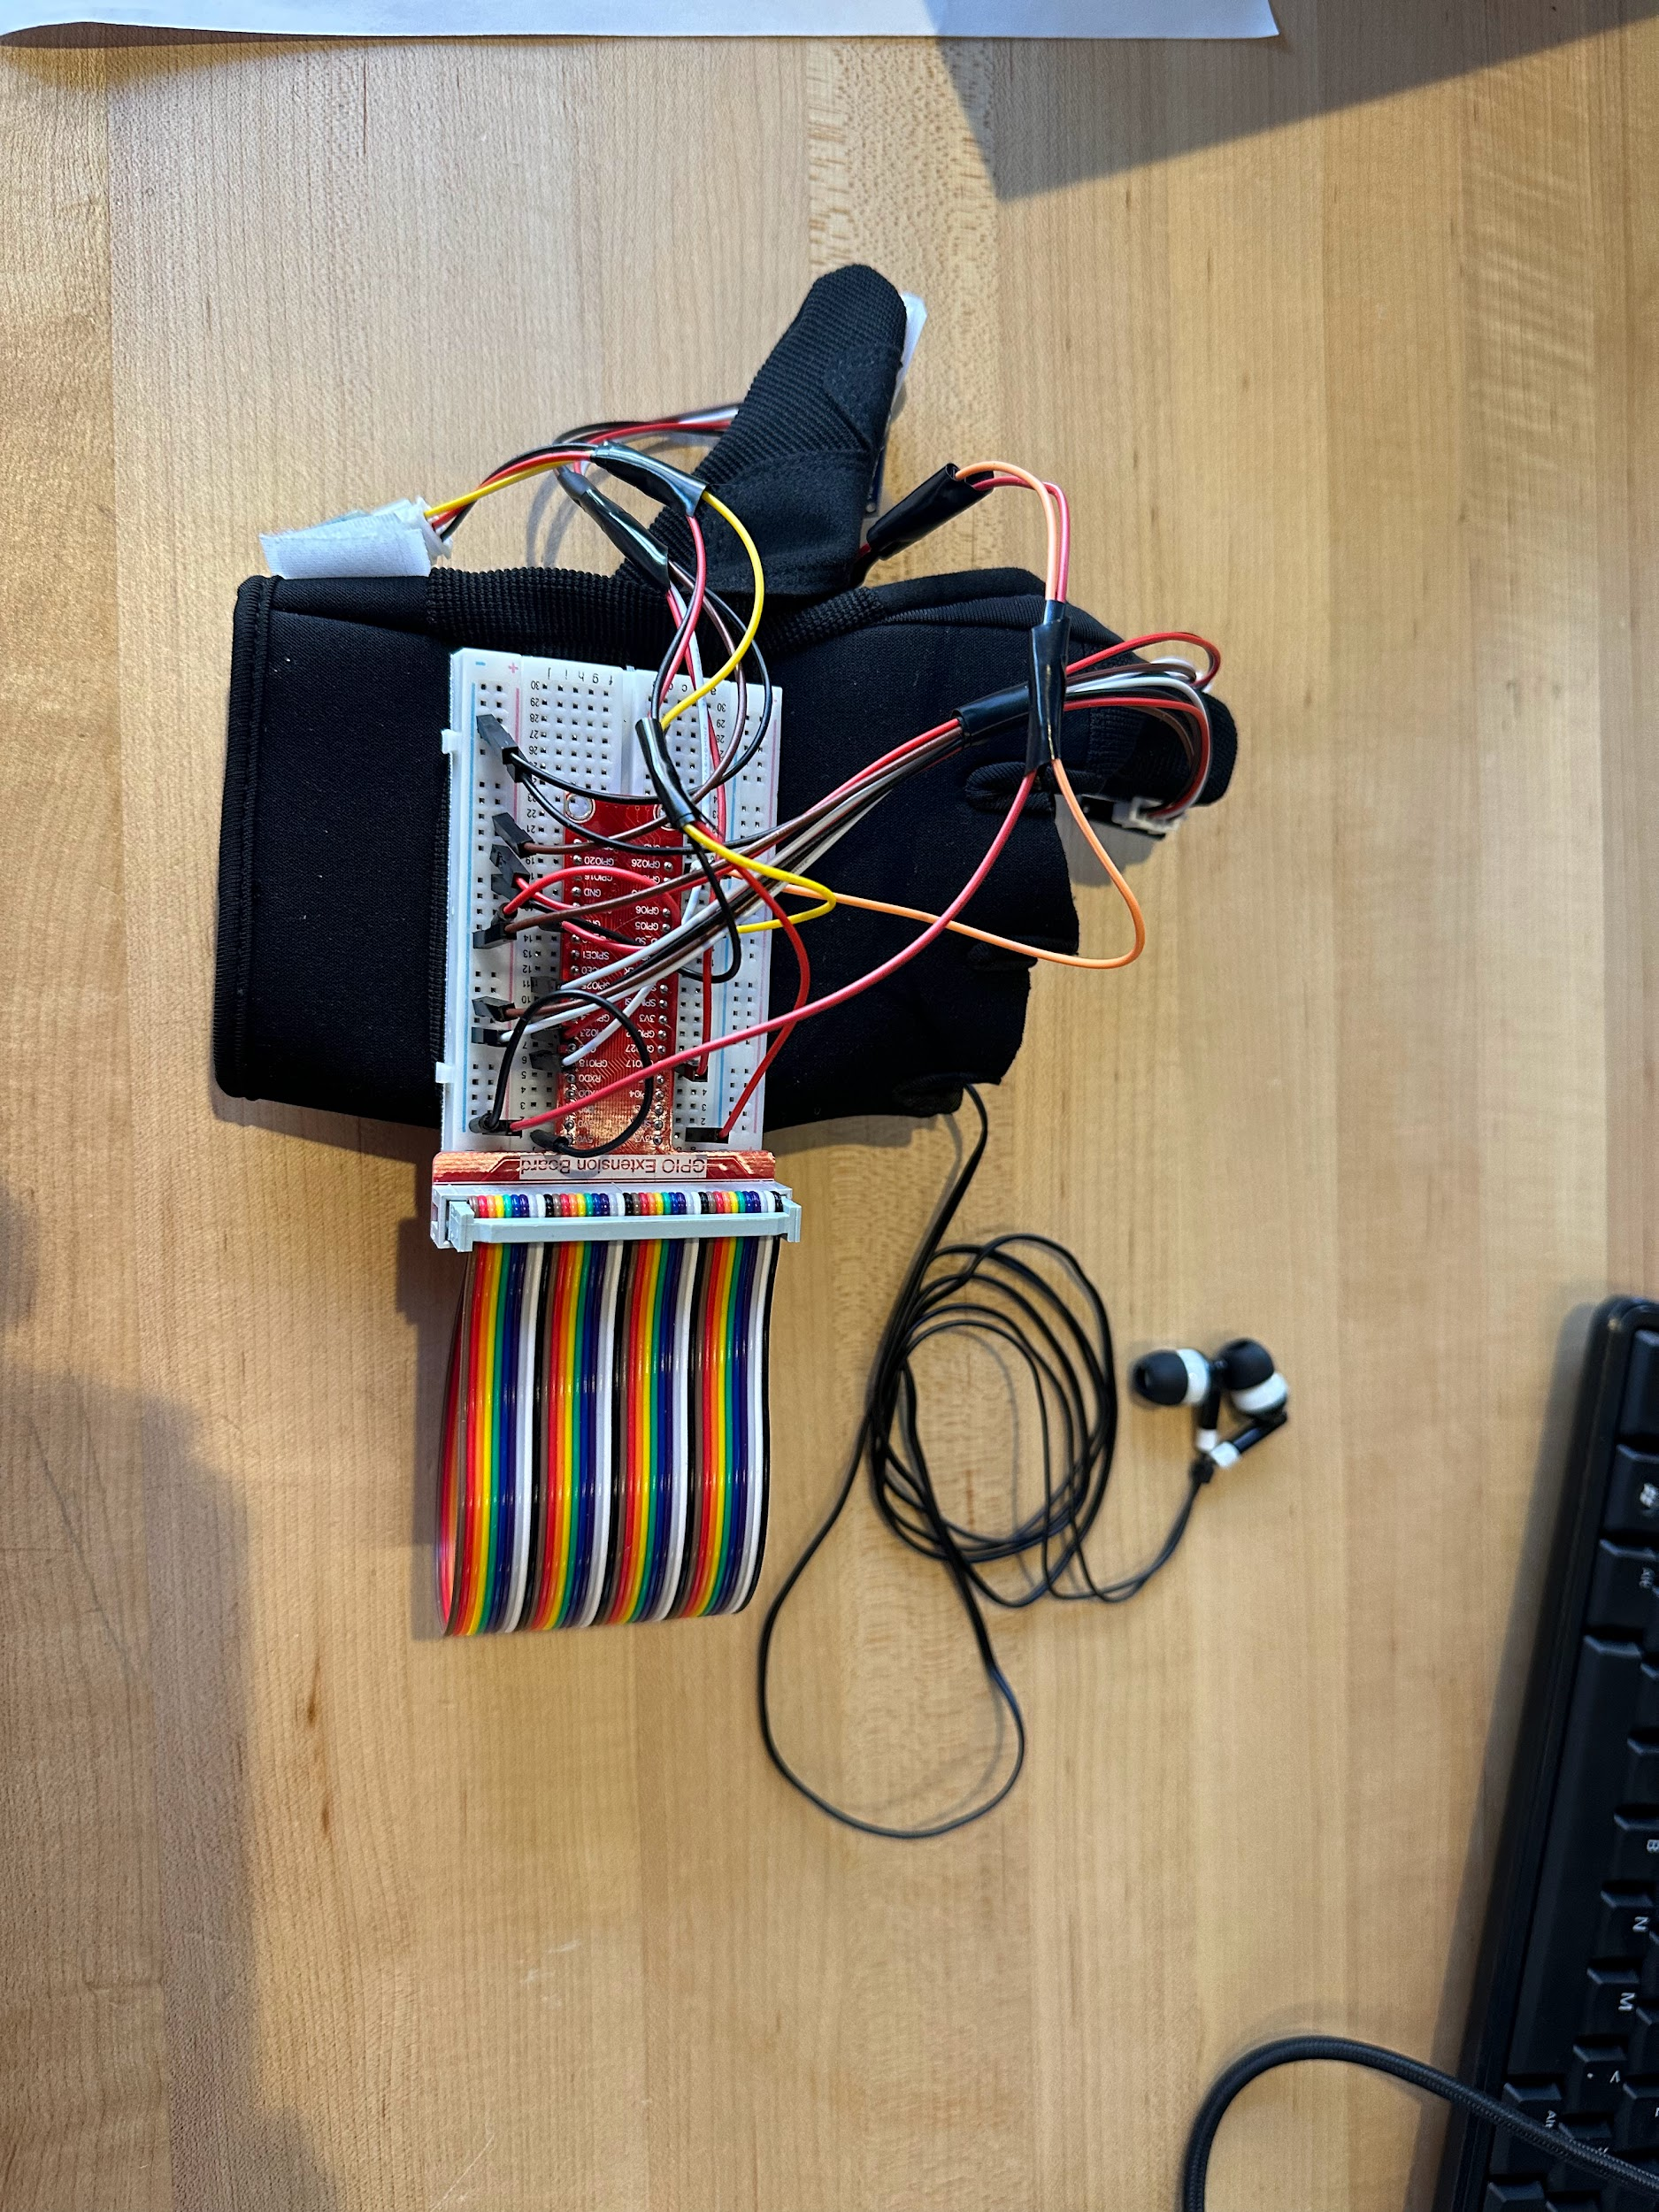
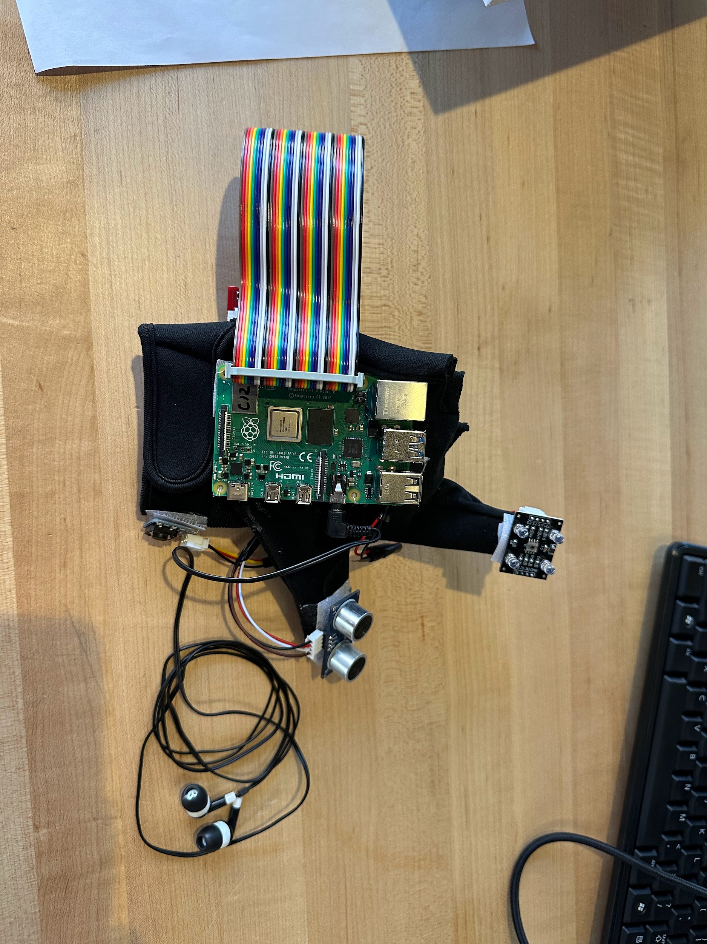
Kaitlyn

Slide 9
FEEDBACK
Things We Changed:
Power button delay
RGB sensor calibration
Sewing for security
Other Concerns:
Not enough colors

Slide 10
CHALLENGES AND LIMITATIONS
Color Detection Limitation:
inaccurate sensor
more colors = less accuracy
lighting changes
would need more expensive sensor for market
Other Challenges We Faced:
raspberry pi & board bulkiness
wires
battery pack

Slide 11
QUESTIONS?

